Slide 1

Predicting Statistics in Baseball
Wesley Chapman

Slide 2
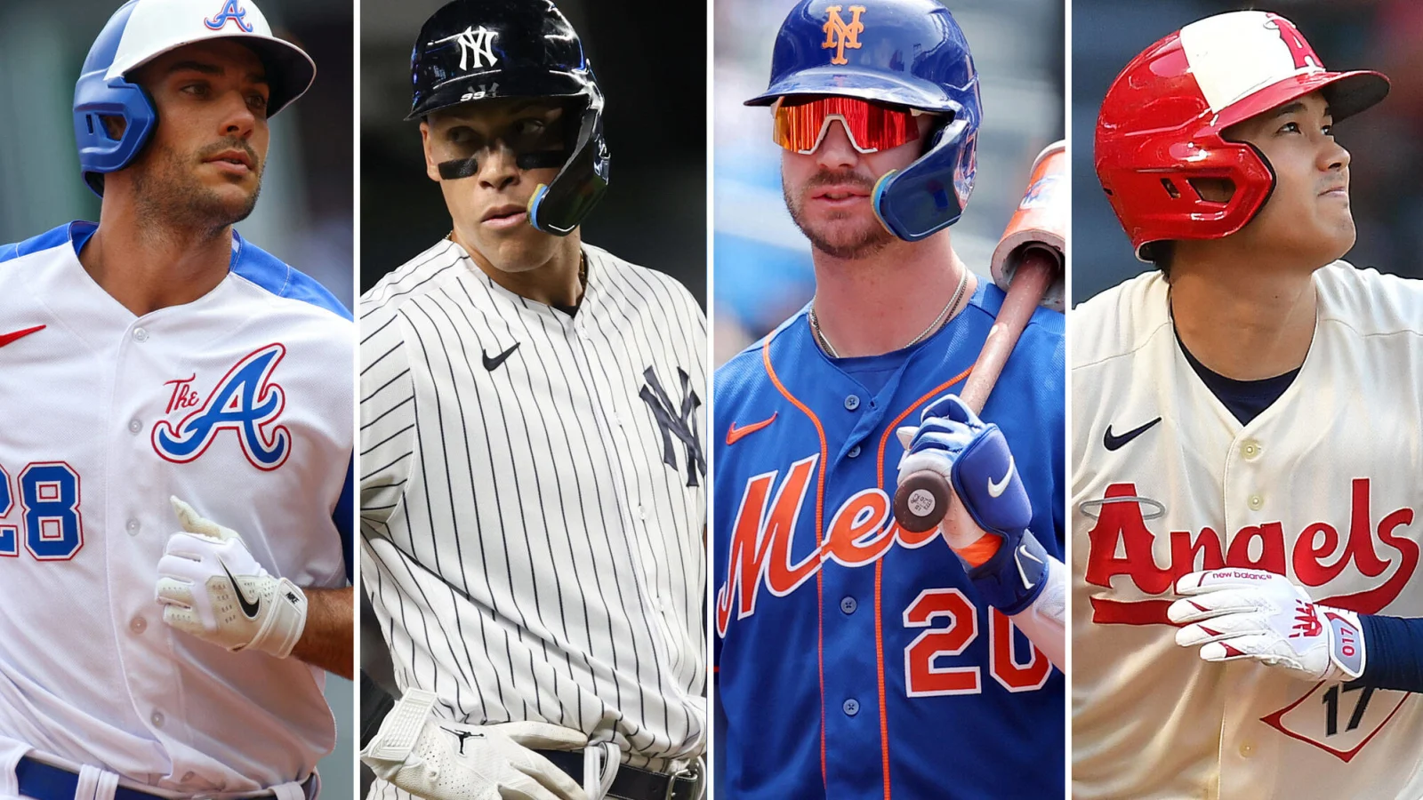

Problem Being Addressed
This project looks at how predictable the stat On Base Plus Slugging (OPS) is in baseball, based on various other offensive statistics.

Slide 3
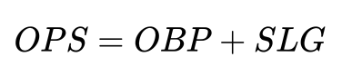
What is OPS?
The dependent variable being predicted is On Base Plus Slugging (OPS), which is a sum of two independent stats in baseball - Batter On Base Percentage, and Batter Slugging Percentage.
OPS measures a batter’s ability to get on base and to hit for power.

Slide 4
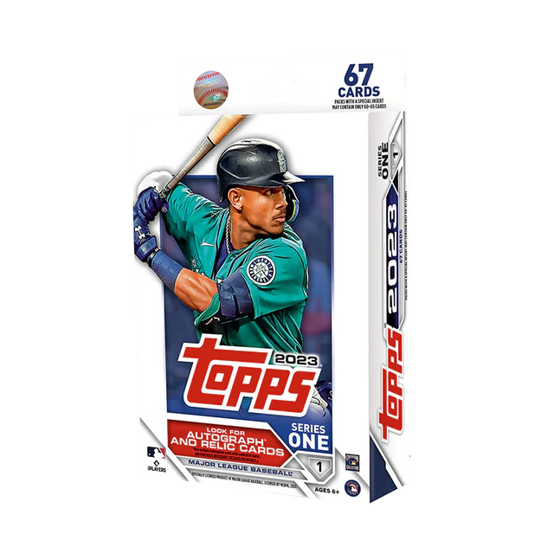
Why?
Why choose baseball statistics
OPS
Who would have interest / be impacted
Player scouts
MLB fans
Team owners/front offices
Predicted OPS > Actual OPS
Implications of better solutions
More comprehensive stat

Slide 5
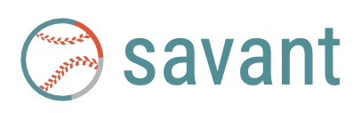
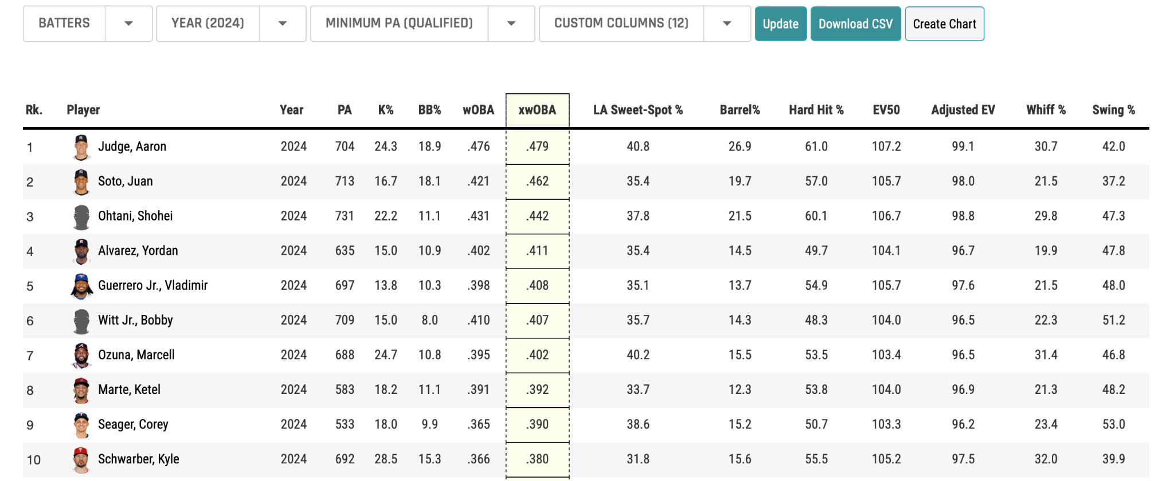
Data Source
Baseball Savant is a website that covers hundreds of MLB analytics and player statistics, with data for every MLB player.
Data available to public
Downloadable CSV files
Customizable tables

Slide 6
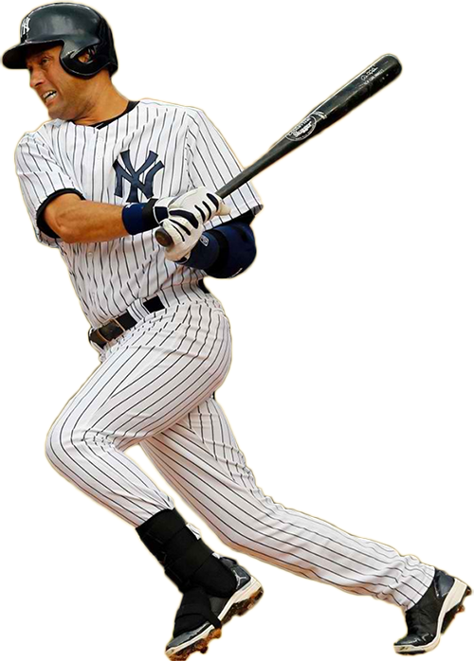
Project Data Constraints
Years: 2019, 2021-2024
Minimum plate appearances: 502 (qualified hitters)
Hitting Metrics:
Singles
Doubles
Triples
Home runs
Strikeouts
Walks
Batting average
Runs batted in
Total bases
Stolen bases
Barrel percentage
In zone percentage
OPS

Slide 7
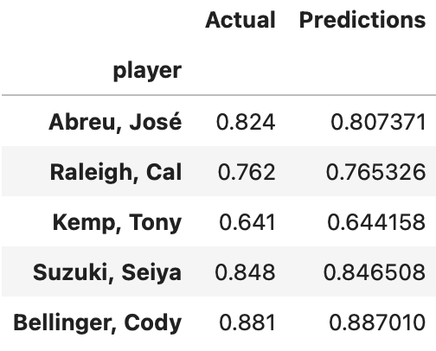
Techniques used
Multiple Linear Regression:
Allows for several independent variables
Predicts dependent variable based on IV’s
Predicts OPS
Mean Squared Error:
Evaluates performance of prediction model
Avg squared difference between actual and predicted values
R-Squared:
Evaluates effectiveness of prediction model
Determines proportion of variance of the DV that can be explained by the IV’s

Slide 8
Relationships between variables

Slide 9
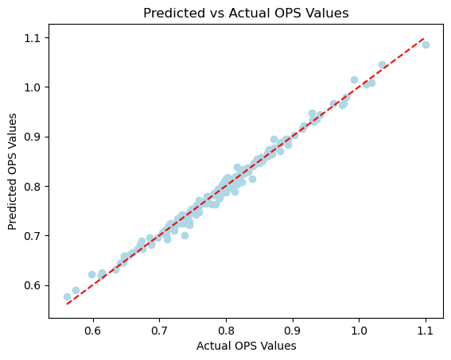
Results
MSE = 0.00008457
Difference between predicted values and actual values is low
R² = 0.99000652
Almost all of the variance in OPS can be explained by the 12 independent variables

Slide 10
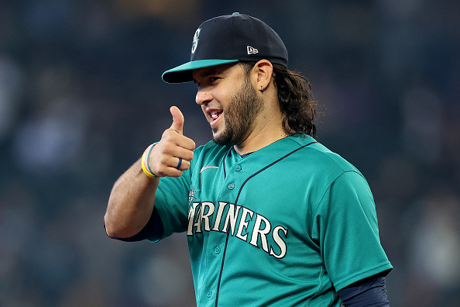
Conclusion
Success!
Multiple linear regression model was highly successful at predicting OPS values.
Low MSE ✅
High R² ✅

Slide 11
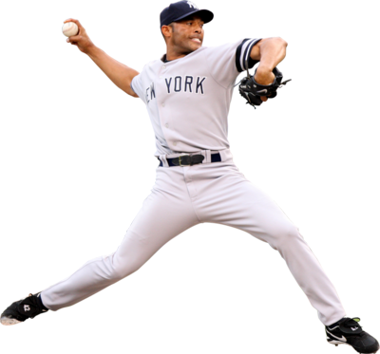
What now?
Model qualified to predict player performance/evaluate player value
Scouts
Fans
Teams
Similar model for pitchers?
Earned Run Average

Slide 12
References
baseballsavant.mlb.com
JupyterLab
baseballsavant.mlb.com
JupyterLab

